Slide 1

Strategic Sales Performance Analysis
Global Chocolate Distribution: Transforming 3,282 transactions into actionable intelligence through advanced data analytics and machine learning.
DATA SCIENCE PROJECT
JANUARY 2026

Slide 2

The Challenge
Critical Business Problems
The organization struggled with unpredictable revenue and poor inventory alignment across global markets.
Data Fragmentation
Unknown Drivers
Reactive Operations
60% of date records corrupted, preventing accurate analysis
Uncertainty about what truly drives profit
Emergency shipping and costly stock-outs during peaks

Slide 3


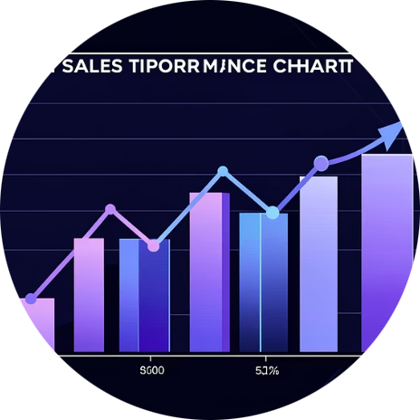
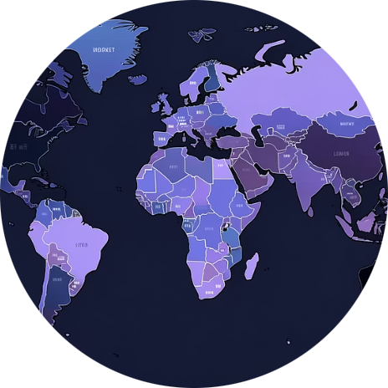
Key Research Questions
Revenue Drivers
Seasonal Patterns
Sales Efficiency
Market Behavior
Which product-country combinations generate the highest revenue?
Are there significant monthly cycles requiring adjusted inventory?
Which salespeople excel at premium selling vs. bulk distribution?
How do purchasing patterns differ across geographic regions?

Slide 4
The Dataset
3,282 Transactions
Global sales records from January 2024 to December 2025
6
60%
Features
Data Recovered
Original data columns
From corrupted records
Data Structure
Sales Person: Account manager for each transaction
Country: Geographic market (UK, USA, India, etc.)
Product: Specific chocolate variety sold
Date: Transaction timestamp (required repair)
Amount: Total revenue generated
Boxes Shipped: Physical volume of order

Slide 5

Data Cleaning: From Chaos to Clarity
01
Temporal Recovery
Repaired 1,900+ corrupted date entries using mixed-format parsing
02
Financial Standardization
Stripped currency symbols and standardized all amounts as floats
03
Categorical Refinement
Standardized country names and applied title case to all text
04
Outlier Management
Used IQR method to handle extreme anomalies in sales amounts

Slide 6
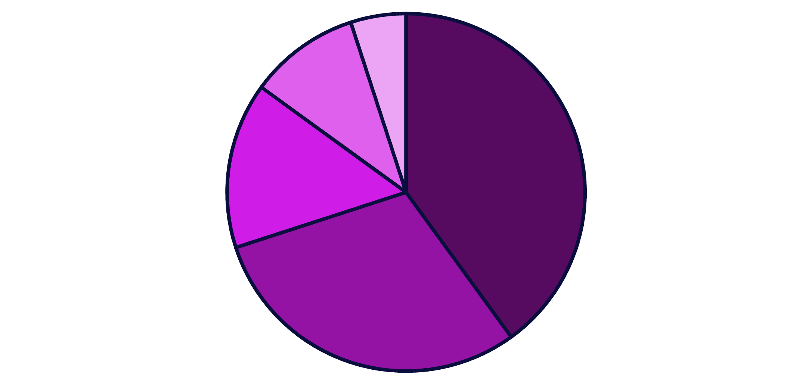
Key Findings: The Power Law
Revenue Concentration
70% of revenue comes from just 2 products: White Chocolate Bites and Dark Chocolate Bars are the "anchor" products driving business success.
This concentration presents both opportunity and risk—these products must be protected with robust supply chains.
White Chocolate Bites
Dark Chocolate Bar
Milk Chocolate
Hazelnut Crunch
Other Products

Slide 7
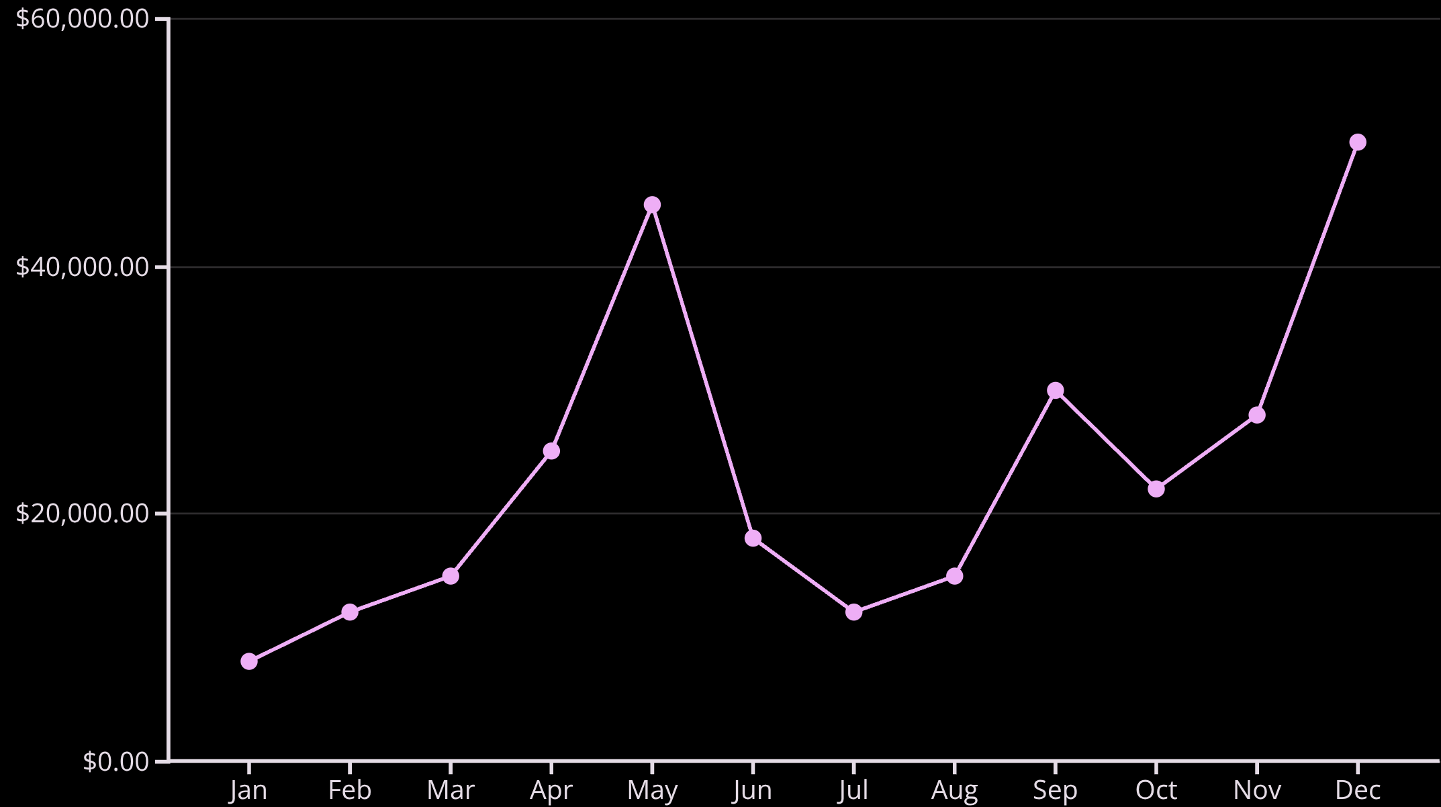
Seasonal Trends: Dual-Peak Pattern
Revenue Cycles
Analysis revealed distinct seasonal patterns with two major peaks throughout the year.
May Peak
December Peak
Spring gifting and Mother's Day drive significant sales increases
Holiday season shows 15% higher price per box—premium gifting

Slide 8



Geographic Market Maturity
UK: Stable Cash Cow
USA: Growth Frontier
India: High Potential
High volume with low variance—predictable demand and mature operations
High volatility with mix of bulk and premium orders—unstandardized market
Currently low density but steady month-over-month growth—expansion opportunity

Slide 9

Predictive Model Performance
Random Forest Regressor
Developed a predictive model achieving R-squared score of 0.90, enabling accurate revenue forecasting.
0.85
0.60
12.4%
Volume Correlation
Price Correlation
YoY Growth
Annual increase
Boxes shipped
Price per box
Key Insight: While volume drives revenue, unit price is an underutilized lever for growth.

Slide 10




Strategic Recommendations
Secure Supply Chain
Seasonal Optimization
Establish 15% safety stock buffer for anchor products
Finalize holiday inventory by October; launch off-season campaigns
Market Segmentation
Value-Based Selling
UK: cost reduction; USA: premium focus; India: volume growth
Train sales team on premium products; incentivize total revenue
Bottom Line: Pivot from volume-only strategy to value-driven, seasonally-optimized approach for sustained growth and profitability.

